Slide 1

Governance – Data Request
Managing Data Access Requests with DRT (Data Access Request Tracker)
Setayesh Sanavi

Slide 2

How is DRT different form
Digital Data Sharing Agreement (DSA) Tool:
It helps you create a customized legal agreement for sharing data with others.
You fill out a static form about your data and how it can be used, and it generates a document you can download.
Data Request Tracker (DRT) System:
Manages the process of requesting access to data.
A data owner sets up a form for the requestor to fill out. The owner can then accept, reject, or ask for changes to the request.
It tracks the entire process, but the final agreement is signed outside the system.
In short, DSA is about creating agreements, while DRT is about managing requests for data.

Slide 3


Building the system
Questionnaire authoring tool
License library
Questionnaire library
DRT Interface
Link table
link, questionnaire SAID, owner ID, owner email, active/inactive
DRT-DS
Negotiation data
(append only)
nLink table
link, questionnaire SAID, owner email, negotiation data identifier, role (owner or requestor)

Slide 4
Owner ID | Associated email
0001 | PI@uog.ca
0002 | owner@sfu.ca
Current State
Questionnaire authoring tool
License library
Questionnaire library
DRT Interface
(eg.com)
Link table
link, questionnaire SAID, owner ID, owner email, active/inactive
DRT-DS
Example Link Table:
Link | Quest. SAID | Owner ID | expiry_date | Data_label(array of tags) | status
https://eg.com/f542gh52s | Elkjnb;kjkndfg | 0001 |  | Cow data | active
https://eg.com/f5sdfwer52s | Elkjnb;kjkndfg | 0001 |  | NSERC grant 345245 | inactive
https://eg.com/3r5g6342g | Emvmvmfjfms | 0002 |  | DOI://10.2158.06
https://eg.com/23terarg64 | Elkjnb;kjkndfg | steward@uog.ca | 2022/05/16
https://eg.com/glt9834ng | Elkjnb;kjkndfg | PI@laval.ca
https://eg.com/5df5rtg51 | E0887lkdfgsdf | PI@uog.ca | 2023/02/06
Notes:
There needs to be a list of owner emails in the DRT-DS for authentication. The link table could also be in the DRT system, but there would be more steps to expire the link or for an owner to look up existing links.
The link table is less secure in the DRT-DS, any author can technically change the link table for any other owner. In a Git system you could trace who made the changes and revert.
May not be able to name the schema bundle the SAID because it may have forbidden characters. May need another table that maps questionnaire SAID to file name.
Roles? Owner and Steward, can specify two emails. Owner is mandatory and owner only can download a license. Steward also receives notifications when a response to a data request is needed.?
Can owner change email address? Create an ID for owner, and a table that links an owner ID to an email. Then to change email address the owner just changes their email address in the ownerid<>email table. This owner_ID table could also include a label, and in the future we could add secondary email addresses (e.g. for a data steward).
The dataset is just a label that the owner wants the summary statistics on. They can subdivide the data! Or even they can devide the dataset by the projects or grants so that the owners can request for summary statistics on the projects as well!
But we might have multiple project granted the same. Its not even a dataset we are having multiple data in that column. Data_lable is sufficient.
(what if we want statistics from NSERC data which is for cow data? Is data lable a single value or an array? It adds complexity! Do we want that much of complexity? The owner can have the array of tags and then later ask for the statistics. For now we go with the single label tags and not array!)
There is a 'boot-up' link. In the DRT-DS there is a table with the questionnaire SAID/license/ownerID/data tags and the 'boot-up' link.
The owner shares the boot-up link.
The requestor clicks on that link.
The link is used to start the request, the information it is linked to in the DRT-DS table is used to populate the nLink table. In the nLink table, new links are generated for both the requestor and owner. The original 'boot-up' link is not used again.
Other requestors will use the 'boot-up' link as well (it is not specific to any request). They will have the same process, the information from the boot-up link is used to populate the nLink table which is where their new specific negotiation links are stored.
The questionnaire schema files will be stored in a folder in the DRT-DS. Every day (or more frequent) the DRT would go to the DRT-DS and retrieve a cache copy of everything in the DS.
Then the questionnaires will be in the DS cache.

Slide 5
Current State
Questionnaire authoring tool
License library
Questionnaire library
DRT Interface
(eg.com)
Link table
link, questionnaire SAID, owner ID, owner email, active/inactive
DRT-DS
Requestor Table
Example Requestor Table:
Requestor_ID | Requestor_email | OTP | OTP_expiry | Is_verified
1234 | R.1@uoguelph.ca | otp_value | 2024-09-10T12:10:00Z | True/False

Slide 6
Current State
Questionnaire authoring tool
License library
Questionnaire library
DRT Interface
(eg.com)
Link table
link, questionnaire SAID, owner ID, owner email, active/inactive
DRT-DS
Requestor Table
Negotiation data
(append only)

Slide 7
Data structure of the negotiation data
The data for all questions and responses is collected in a single table.
The answers are interweaved with comments (back and forth)
Negotiation_ID | Conversation ID | Requestor Responses | Owner Responses | State | negotiation_status | questionnaire_ID (SAID) | Timestamps
0001 | 0001-01 | {"q1": "John", "q2": "", "q3": "good"} | {"comment": "Thank you, this is acceptable."}, | 1, 2, 3, 4 | open, completed, archived(move to another table) | Elkjnb;kjkndfg | 2024/12/18
Notes:
The owners response question by question (ask it in the meeting) // no need for state and negotiation status both? // risk: if the owner accept a questions answer the requestor cannot change it anymore. // in the requestor response table we can have an array of question and a flag to see if the question have been accepted by the owner, if yes, not editale by the requestor in the next conversation.
What happens when a requestor submits their answers, then clicks the link again and adds more information. The DRT could identify that the answers have already been submitted and the requestor is to wait for a response from the data owner and vice versa.
Note: negotiation data tables will be different for each questionnaire. Does each negotiation have its own table?
It is likely that each owner ID will be given a folder on the server. Inside each owner folder will be an individual negotiation file for each separate negotiation recorded as a JSON file with answer and responses stored in this single JSON file. These files may even be sorted by year.
To deal with deletion of data – the owner may still wish to record the summary statistics. Perhaps in addition to the JSON negotiation file there is also an anonymized summary statistics file for each owner which counts how many data requests each dataset receives.

Slide 8
Negotiation Table Features
Negotiation ID: Links back to the NLink Collection for identifying which negotiation this conversation is part of the system (requestor’s link, owner’s link, and negotiation data).
Conversation ID: Unique for each conversation round, allowing the system to track multiple rounds of back-and-forth communication.
Requestor Responses: Stores the answers provided by the requestor. These responses are viewable and editable only when the state is in requestor_open.
Owner Responses: Stores the owner’s feedback and requests for clarification, editable when the state is in owner_open.
State: Ensures that only one party can edit the form at any given time, preventing overlap in editing.
negotiation_status: Tracks the overall status of the negotiation (e.g., open, completed, or archived).
questionnaire_ID (SAID) : Every negotiation is tied to a specific questionnaire, ensuring that the correct set of questions and responses is being negotiated.
Timestamps: Track when the conversation started(for Expiration) and when it was last updated.

Slide 9
Example of the conversation and how we can save the responses:
"conversation_rounds": [ // List of all conversation rounds between requestor and owner
{
"conversation_ID": "0001-01", // Unique identifier for each conversation round
"requestor_responses": { // JSON structure containing the requestor's responses
"q1": "John",
"q2": "",
"q3": "good"
},
"owner_responses": { // JSON structure containing the owner's feedback or requests
"comment": "Please clarify your data analysis." // go question by question to have better feedback( accept & comment/ or just comment)
},
"state": "owner_open", // Indicates who has control (requestor_open, owner_open)
},
{
"conversation_ID": "0001-02",
"requestor_responses": {
"q1": "John",
"q2": "Doe",
"q3": "good",
"clarification": "Clarified as per owner's request."
},
"owner_responses": {
"comment": "Thank you, this is acceptable."
},
"state": "completed", // State changes once both parties have agreed
}
],

Slide 10
Archived Negotiations Table: in DRT
negotiation_ID | questionnaire_ID | archive_timestamp | archived_data
0001 | Elkjnb;kjkndfg | 2024-09-15T12:00:00Z | "requestor_responses": { "q1": "John", "q2": "Doe", "q3": "good" }, "owner_responses": { "comment": "Clarified methodology, approved." } }
negotiation_ID: Reference to the negotiation from the NLink table.
questionnaire_ID: Maintains a reference to the questionnaire that was used in the negotiation.
archive_timestamp: Timestamp of when the negotiation was archived.
Archived Data: Contains the entire conversation history in a JSON format for easy retrieval.

Slide 11
Current State
Questionnaire authoring tool
License library
Questionnaire library
DRT Interface
(eg.com)
Link table
link, questionnaire SAID, owner ID, owner email, active/inactive
Requestor Table
DRT-DS
Negotiation data
(append only)
nLink table
Notes:
Each negotiation data will have two links. One link for the owner and one link for the requestor. These emails cannot be changed. If they are to be changed there must be a new request started. The owner email might be only the owner ID, and then the DRT would go back to the DS to look up in the ownerid<>email table to find the owner email address (in case it changes).
Archive may be necessary to add so that after a license has been created with the accepted data request, the data no longer appears in selection lists and the owner doesn’t have a large list to scroll through. When archive is true then the links no longer show the negotiation data. Need to also be able to delete data. EU regulation and the right to be forgotten. Archive could actually be three options. Open, Closed, Archived.
Negotiation IDs must be unique for each specific negotiation. They may reflect the owner ID and point to the likely JSON file for each separate negotiation.
Queuing – if a data owner receives many requests in a single day can the owner make an option to have the summary with all the links sent once a day. Queuing would be indicated on the Linktable of the DRT-DS

Slide 12
Nlink Table/Collection
Negotiation ID | Owner ID | Owner link | Requestor email(or ID) | Requestor link | Questionnaire SAID | State | Expiration Date | Last Activity | dataset_ID
0001 | 1 | https://eg.com/f542gh52s | me@ubc.ca | https://eg.com/3r5g6342g | Elkjnb;kjkndfg | 1 = requestor open | 2024/12/18 | 2024/09/18 | Dataset_XYZ
0002 | 2 | https://eg.com/glt9834ng | Fred.asker@inst.edu | https://eg.com/5df5rtg51 | Emvmvmfjfms | 2 = owner open
0003 | 3 | https://eg.com/848834re | want@laval.ca | https://eg.com/23terarg64 | Elkjnb;kjkndfg | 3 = completed 4=closed
Notes:
We have the requestor email in the requestor table, should it be here as well, or should we just keep the ID here?
Connect the DRT to the Data Store (DRT-DS)
At the very beginning we didn’t tell the DRT where the datastore(s) is. So, DRT is probably is going to have an internal table/JSON (in order to a private github we need the environmental variable from github. So, DRT need to have that information stored privately and encrypted.)
Organization hosts the DRT
Points the DRT to the correct DRT-DS
Config file
There can be multiple DRT-DS. For example, a researcher may have their own GitHub account already set up as a DS, and there may be additional GitHub DSs owned by other researchers who don’t want to combine. How do you manage unique owner ID?
(we need to ask the requestor_ There can be multiple DRT-DS. For example, a researcher may have their own GitHub account already set up as a DS, and there may be additional GitHub DSs owned by other researchers who don’t want to combine. How do you manage unique owner ID?
)
I was just thinking, for DRT summary statistics we could have one data row per negotiation. The negotiation data wouldn't include the details and we can talk with the team about exactly what to anonymize. (e.g. take the domain name of the email address and not the user identifier (e.g. uoguelph.ca). We would also include all the tags the owner had tagged for that negotiation in the original link request on the data store.
Then the owner could do whatever data ordering the would want. How many requests for data tagged NSERC were made in 2024. The average length of time it took from start to acceptance or rejection of a data request. What domains were the majority of requests made from.
For the DRT config file that lets it connect to other DSs (like the GitHub DS) the config file should include something like cache rate and the administrator can config how often everything is copied down from the DS into the DRT and how often it is sent back.
How DRT Updates the Summary Statistics:
Real-Time Updates in DRT: As negotiations are submitted, completed, or rejected, DRT updates the internal summary statistics for active negotiations. These statistics are stored internally in the DRT system during the active phase of the negotiation.
Export to GitHub: Once a negotiation is completed or archived, DRT exports or updates the summary_statistics.json file in the DRT-DS (GitHub). The file is then version-controlled by GitHub, allowing the owner to access it at any time. The export process is automated, meaning that each time a negotiation status changes (e.g., completed, rejected), DRT will update the relevant statistics and push them to GitHub. (or at the end of day or week/different intervals based on the needs)

Slide 13
Nlink Features Explanation
Negotiation ID: Links to the Negotiation Data Collection for the specific negotiation.
Owner ID: can be used to fetch the owner’s email from the data store. This allows DaRT to remain isolated from storing sensitive owner details.
Requestor Email: The requestor’s verified email is stored here after OTP validation.
Requestor Link & Owner Link: These are tokenized URLs that grant access to the negotiation for each party. The state of these links changes as the negotiation progresses.
Questionnaire SAID: The questionnaire that is being filled for this negotiation.
State: The state determines who can act next. It is crucial for managing the flow of communication.
Expiration Date: This helps manage expired links, ensuring that once a link is no longer valid, a new one is generated if needed.
Last Activity: Helps monitor activity and update the expiration as needed.
dataset_ID: Unique ID of the requested dataset for the summary statistics file.

Slide 14
Summary Statistics
owner_ID | summary_date | datasets_requested | overall_stats
1234 | 2024-09-10 | [{ "data_label": "Dataset_XYZ", "total_requests": 12, "completed_requests": 8, "rejected_requests": 2, "in_progress_requests": 2, "time_period": "2024-01-01 to 2024-09-10"}, {}, ] | {"total_requests": 17, "completed_requests": 11, "rejected_requests": 3, "in_progress_requests": 3}
Notes:
Data_ID: owner can ask for the summary statistics for “soil” data as a whole or for the subsets like “soil123” and “soil456” datasets. So, we should know what we want to save in the table for this part as the data_lable or….
If you want to divide the request into types, you must make separate questionnaire SAID.

Slide 15
Explanation of the Summary Statistics File
owner_ID: Each owner has a unique summary statistics file based on their owner_ID. This file contains anonymized information about the requests they received for different datasets.
summary_date: This is the date when the summary statistics were last updated. Each time DRT exports the statistics to GitHub, the date is updated.
datasets_requested Array: (very good idea)
dataset_ID: Unique identifier for the dataset requested.
dataset_name: (Optional) Readable name of the dataset for easier identification.
total_requests: The total number of data access requests for this dataset.
completed_requests: The number of requests that were completed and successfully resolved.
rejected_requests: The number of requests that were rejected by the owner.
in_progress_requests: The number of requests that are still ongoing and haven’t been completed or rejected yet.
time_period: This is the date range during which the requests were made.
overall_stats: This section provides a high-level summary of the owner’s data requests across all datasets.It includes:
Total requests across all datasets.
Completed requests, rejected requests, and in-progress requests.

Slide 16
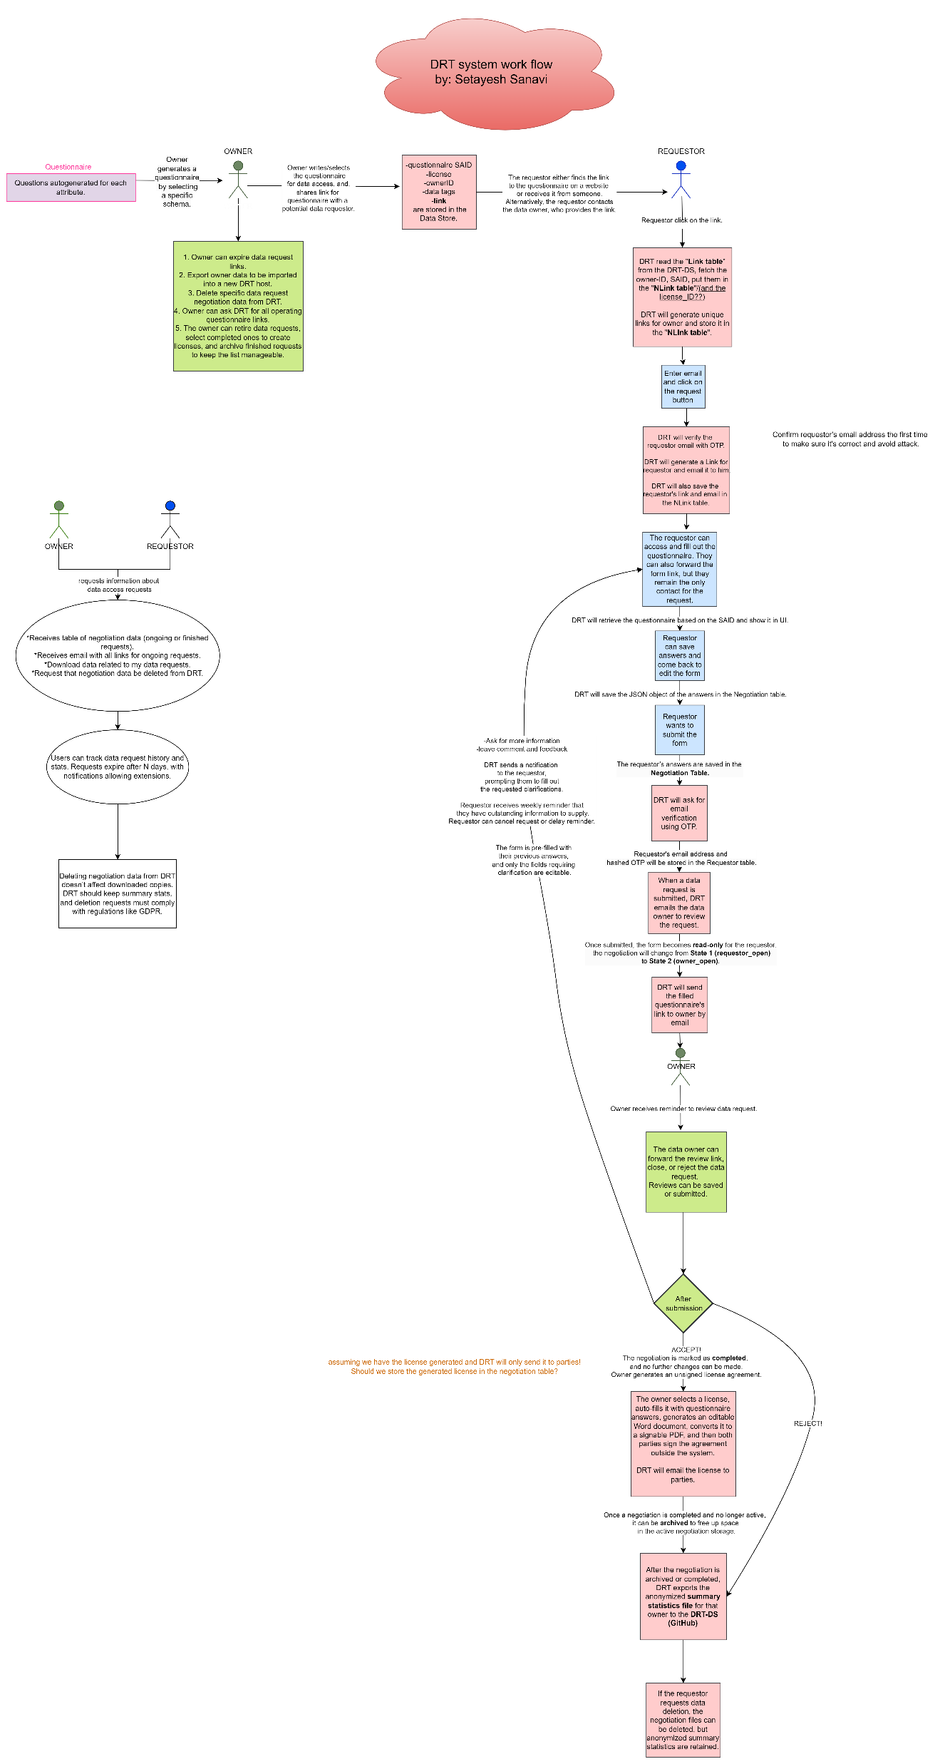

Slide 17

THANK YOU
Agri-food Data Canada at the
University of Guelph is an innovation platform for Canada's agriculture
and food sectors.
50 Stone Road East, Guelph, ON N1G 2W
adc@uoguelph.ca
519-824-4120 Ext. 53547
agrifooddata.ca

Slide 18


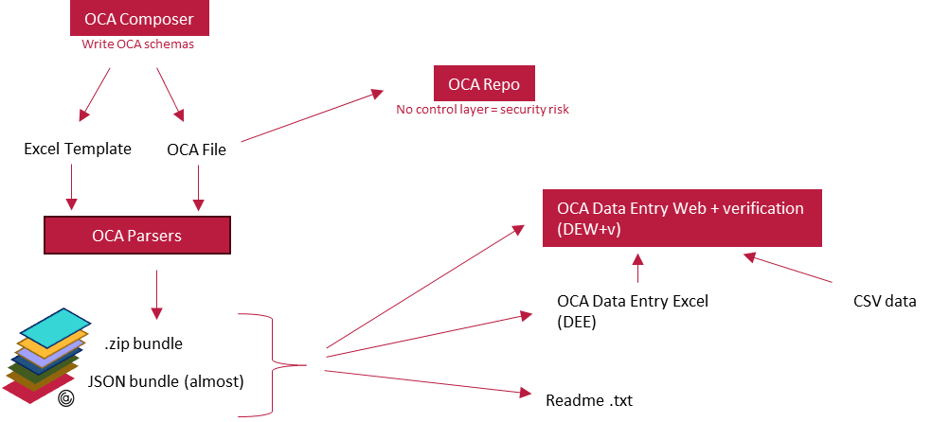
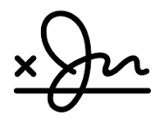

OCA Open Tools
archives
OCA Repo Control Layer
OCA Repo
Development
OCA Repo
Dataverse
Needs lots of design and rework for tracking OCA File changes
stores
Next target – JSON object with SAIDs.
ongoing
Bob’s version
Alice’s version
Data Transit object authoring
Governance resources
Collaborative authoring with catalogue data
Data node collection with DEW+v
Meta
Capture Base
Entry Codes
Labels (EN)
Information (EN)
Labels (FR)
Information (FR)
Required Entries
Entry Code (EN)
✓
✓
Meta
Capture Base
Entry Codes
Labels (EN)
Information (EN)
Labels (FR)
Information (FR)
Required Entries
Entry Code (EN)
contributes
✓
authors
authors
✓
✓
✓
✓
✓
Data Transit object
Collaborative authoring
OCA File
authors
payload
federate
OCA Ecosystem
authors
Provenance ledger
Payload?
DRT
Federate existing nodes
Co-op Hire
Sept 2024
Signature infrastructure
Machine-readable
Governance agreements
educates
GOV Hire
Sept 2024
Data node
Machine-actionable
Governance agreements
Governance resources

